Slide 1
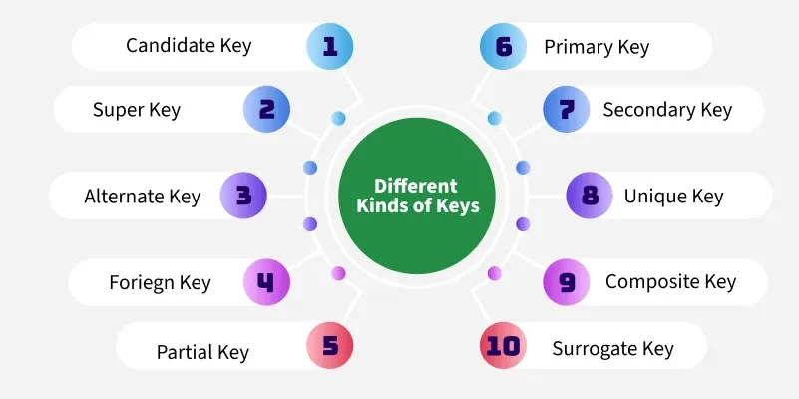
Keys in DBMS
Keys are fundamental components that ensure data integrity, uniqueness and efficient access. It is widely used to identify the tuples(rows) uniquely in the table.
We also use keys to set up relations amongst various columns and tables of a relational database.

Slide 2
What’s the Need for Keys in DBMS?
Unique identification: A key ensures you don’t mix up two rows or treat them as the same entry.
Accurate relationships: Different tables can connect in an orderly way, preventing stray links or mismatched data.
Quicker searches: You can find specific rows more easily, which means less scrolling and more precision.
Fewer duplicates: A unique marker keeps the table from piling on identical rows that only add clutter.
Reliable integrity: If you rely on correct data for projects or queries, a key makes each record trustworthy and consistent.

Slide 3
Keys in DBMS
Keys in DBMS | Description
Super Key | One or more columns that can single out every row, even if they include extra attributes not strictly needed for uniqueness.
Primary Key | The minimal set of attributes needed to identify a row without any duplicates or null values.
Candidate Key | Any key that qualifies to become a primary key because it’s both unique and minimal.
Alternate Key | A candidate key not used as the primary key. It still uniquely identifies rows, but it isn’t the main choice for the table.

Slide 4
Foreign Key | A column in one table that matches a primary key in another table to keep their data aligned.
Composite Key | Two or more columns combined to form a unique identifier. Helpful when no single column can do the job on its own.
Unique Key | Demands that all values differ within a column (or set of columns), though it typically allows one null. It prevents repeated entries.
Surrogate Key | A system-generated key with no direct real-world meaning, often auto-incremented or assigned by the database itself.

Slide 5
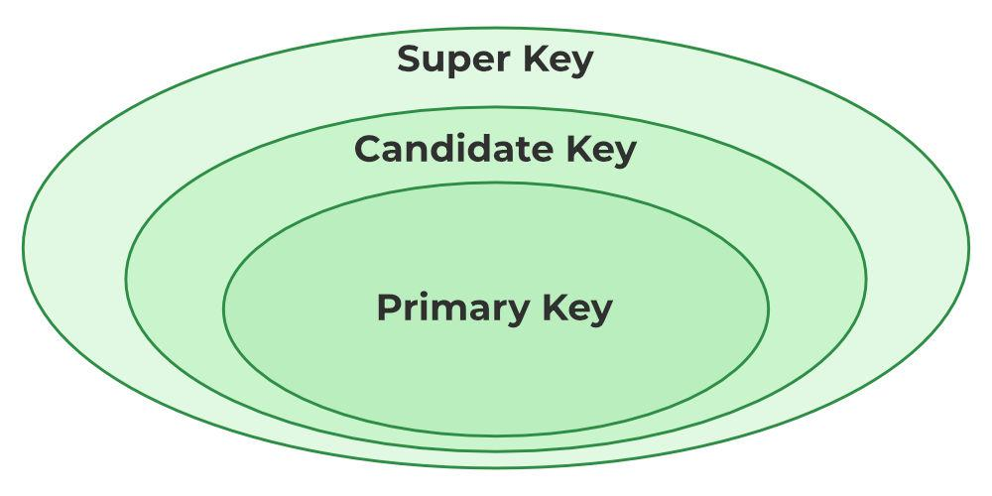
Super Key
A super key is a collection of one or more columns that can identify every row in a table without confusion. It may include extra columns that are not strictly necessary for uniqueness, but any row that matches all the columns in the super key is guaranteed to be one of a kind.

Slide 6
Example : Super key
Assume there is a ‘Students table’ that stores registration data.
A single column like StudentID can uniquely identify rows, and combining StudentID with other columns (such as Email or ContactNumber) also forms a super key.
A super key does not have to be minimal. That is why StudentID + Email is still a valid super key, even if StudentID already does the job by itself.
StudentID | StudentName | ContactNumber | Email
1 | Arun | 98765XXXXX | arun@example.com
2 | Meera | 99887XXXXX | meera@example.com
3 | Kirti | 98767XXXXX | kirti@example.com

Slide 7
Examples of Super Key
(StudentID + Email) in a Students table, where StudentID is already unique, but including Email still maintains uniqueness.
(EmployeeID + DepartmentID) in an Employees table, even if EmployeeID alone identifies rows, that extra department column does not break uniqueness.
(ProductCode + BatchNumber) in an Inventory table, which ensures each product-batch pair is distinct.

Slide 8
Importance of Super Key
Guarantees Uniqueness: Every row is always distinct as long as it matches the super key attributes.
Supports Flexible Design: Extra columns in the key allow more detailed queries, even if only one column was needed for uniqueness.
Eases Data Validation: Insertion of a record by duplicating every super key column is not allowed, which helps maintain clean data.
Forms a Base for Candidate Keys: A candidate key comes from a super key once any unnecessary attributes are removed.

Slide 9
Primary key
A primary key is the minimal set of columns that pinpoint a row in a table. It does not allow duplicates or empty values, which makes it the firmest boundary, preventing confusion between records. This key is the preferred choice for queries that count on accurate and immediate results.

Slide 10
Example : Primary key
‘Books table’ holding details such as BookID, Title, Author, and Price.
You can assign BookID as the primary key.
When you insert or update entries, BookID guarantees each book is distinct, avoiding any messy overlaps.
BookID | Title | Author | Price
101 | A Tale of Two Cities | Charles Dickens | INR 300
102 | Pride and Prejudice | Jane Austen | INR 280
103 | The Great Gatsby | F. Scott Fitzgerald | INR 350

Slide 11
Example & Rules of Primary Keys
StudentID in a Students table
EmployeeNumber in an Employees table
OrderID in an Orders table
Rules for Primary Keys in DBMS
No duplicates: You cannot repeat the same primary key value across rows.
No null values: A primary key field must always contain data.
Minimal attributes: It should include only the columns you need for unique identification.
One per table: You cannot define two primary keys in the same table.

Slide 12
Primary Key vs Unique Key
Primary keys and unique keys both keep duplicate data out of your table. They do so in slightly different ways, especially when you consider their rules on null values and how they fit into the bigger design. Understanding these differences can make your database structure more efficient and flexible.

Slide 13
Aspect | Primary Key | Unique Key
Definition | Identifies rows by disallowing duplicates and nulls. | Demands distinct values in a column but can allow one null (depending on the database system).
Number Allowed | Only one per table | You can create multiple unique keys in the same table.
Handling Nulls | Never permits null values | Typically allows one null, but disallows duplicates among non-null entries.
Role | Serves as the main reference for relationships in other tables. | Provides an extra layer of uniqueness without being the table’s primary reference.
Enforcement Method | Declared with the PRIMARY KEY constraint | Enforced via the UNIQUE constraint

Slide 14
Candidate Key
A candidate key is a minimal group of columns that guarantee a row’s uniqueness in a table. Unlike a super key, which can hold extra columns that aren’t required for uniqueness, a candidate key includes only what’s strictly necessary.
You may find several candidate keys in a single table, but each one meets the same standard: no duplicates and no extra fields that could be removed without losing uniqueness.

Slide 15
Candidate key
FlightID | FlightNumber | DepartureTime | ArrivalTime | GateNumber
1 | AI-203 | 8:30 AM | 10:45 AM | B5
2 | AI-204 | 9:00 PM | 11:15 PM | B7
3 | AI-205 | 10:00 AM | 12:20 AM | C1
Examples of Candidate Key in Relational Database
(Email) in a Users table, assuming no one shares the same email
(PhoneNumber) in a Contacts table, if it remains unique for each row
(FlightID) in an airline’s flight details table

Slide 16
Rules for Candidate Keys in DBMS
Minimal attributes: Only the columns needed for uniqueness should be part of the candidate key
No duplicates: Every candidate key combination must be distinct in each row
No nulls: Usually, these columns should be filled so they can keep each record separate
Multiple possibilities: A table can hold more than one candidate key

Slide 17
Alternate Key
An alternate key is any candidate key that did not become the primary key. It still uniquely identifies a row in a table but isn’t chosen as the main identifier. That means a table can have multiple candidate keys (like Email and PhoneNumber), but only one of them serves as the primary key. The remaining candidate keys are known as alternate keys.
Examples of an Alternate Key in Relational Database
Email in a Users table when UserID is chosen as primary
LicenseNumber in a Drivers’ table when DriverID serves as primary
RollNumber in a Students table when StudentID is primary

Slide 18
Example : Alternate Key
PatientID | PatientName | PhoneNumber | HealthCardID
1 | Rakesh | 98765XXXXX | HCI-654321
2 | Kavya | 99000XXXXX | HCI-987654
3 | Rohit | 98877XXXXX | HCI-112233
PatientID is primary, and you can treat HealthCardID or PhoneNumber as alternate keys.
Email in a Users table when UserID is chosen as primary
LicenseNumber in a Drivers’ table when DriverID serves as primary
RollNumber in a Students table when StudentID is primary

Slide 19
Rules for Alternate Keys in DBMS
Must be unique: They satisfy the same uniqueness requirement as the primary key.
Part of candidate keys: An alternate key has the potential to be primary but isn’t selected.
No duplication: Rows that share the same alternate key combination cause a conflict.
Cannot be null: Typically, these fields shouldn’t have null entries.

Slide 20
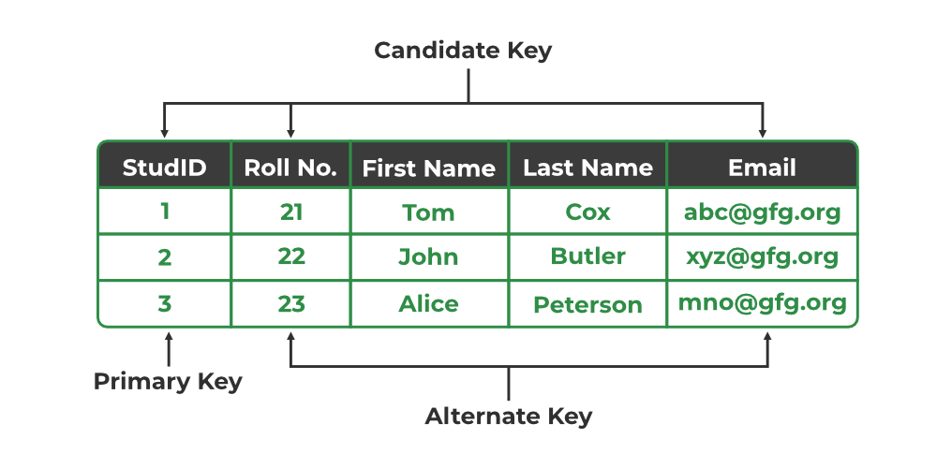

Slide 21
Foreign key
A foreign key is a column in one table that points to a primary key in another table. Its main purpose is to link two tables so that they share information in a consistent way. When you reference a foreign key, you ensure that the data in both tables stays synchronized, and entries only appear if there’s a valid match in the primary key column.
Examples of a Foreign Key in Relational Database
StudentID in an Enrollment table referencing the Students table
BookID in a BorrowedBooks table referencing the Books table
EmployeeID in a Timesheet table referencing the Employees table

Slide 22
Example : Foriegn key
OrderID | CustomerID | ProductName | OrderDate
5001 | 101 | Wireless Mouse | 2025-01-12
5002 | 102 | Keyboard | 2025-01-13
5003 | 101 | Laptop Stand | 2025-01-14
Consider a ‘Customers table’ that holds CustomerID as the primary key.
There’s another table named ‘Orders’, which has OrderID, CustomerID, and details about purchased products.
The CustomerID column in the Orders table becomes the foreign key, allowing you to see which customer placed a specific order.

Slide 23
Rules for Foreign Keys in DBMS
Valid reference: A foreign key must point to an existing primary key (or unique key) in another table.
No mismatch: If the parent key changes or is removed, the matching child entries need to follow the specified delete or update actions.
Possible null: If the relationship is optional, you can leave a foreign key column empty.
Multiple child entries: One key in the parent table can link to many rows in the child table.

Slide 24
Composite Key
A composite key is a combination of two or more columns that together make each row in a table unique. None of those columns alone can serve as the complete identifier, but merging them guarantees one-of-a-kind rows.
Composite keys often appear in many-to-many relationships, where individual columns can repeat themselves, but their pairing remains distinct.

Slide 25
StudentID | CourseID | EnrollmentDate
101 | C001 | 2025-02-08
101 | C002 | 2025-02-09
102 | C001 | 2025-02-10
‘StudentCourse table’ that records which students sign up for which courses.
A single StudentID can appear many times if the same student takes multiple courses.
A single CourseID can also appear many times because multiple students may enroll in the same course.
By merging StudentID and CourseID, you get a unique composite key.

Slide 26
Examples of a Composite Key
(OrderID + ProductID) in an OrderDetails table, which prevents duplicates of the same product line in one order
(StudentID + CourseID) in a StudentCourse table, as shown above
(FlightNumber + FlightDate) in an airline schedule table, ensuring each flight on a particular date stays unique

Slide 27
Surrogate Key
A surrogate key is a system-generated column that identifies each row in a table but has no direct connection to real-world data. Many databases assign an automatically incrementing number as the surrogate key, and this approach offers a stable way to keep records distinct. It won't change over time and doesn't depend on user-provided values or business rules.

Slide 28
Example: Surrogate Key
In a Users table, the column UserID can be auto-incremented by the system.
That means every time a new user is inserted, the UserID automatically increases by one and becomes the new record's surrogate key.
This makes sure each user has a unique identifier that’s never based on any personal details.
UserID | Username | Email | JoinDate
1 | coder123 | coder123@example.com | 2025-01-09
2 | devPro | devPro@example.com | 2025-01-10
3 | designGeek | designGeek@example.com | 2025-01-11

Slide 29
Examples of a Surrogate Key in DBMS
System-Generated Numeric IDs: The database auto-increments an integer each time you insert a row, giving each entry a distinct number.
UUIDs (Universally Unique Identifiers): An algorithm creates long, random strings that are highly unlikely to repeat, giving every row a unique code.
Database-Assigned Tokens: Some systems issue tokens or session IDs on the fly to mark rows without relying on user data.
Hybrid Surrogate Keys: A numeric prefix paired with an increment counter (like ORD-0001, ORD-0002) can simplify sorting while ensuring unique identifiers.

Slide 30

Properties of SQL Keys

Slide 31
Uniqueness: No two rows share the same key value, preventing duplicates.
Non-Null Constraint: Most keys do not allow empty fields, so each record can be fully identified.
Minimality: The key has no extra attributes; if any column is removed, the key no longer guarantees uniqueness.
Stability: Key values shouldn’t change often (or at all). When they do, references in other tables may break.
Entity Integrity: A valid key ensures each record is recognized as a distinct entity, reinforcing the table’s core structure.
Referential Integrity: Foreign keys must match existing primary key values or be null if the relationship is optional. This prevents broken links between tables.
Automatic Indexing: Most databases create indexes on key columns, speeding up searching and ensuring consistency checks.
No Redundancy: The key doesn’t include needless attributes. Each column in the key has a role in making rows distinct.

Slide 32
Benefits of Using Different Types of Keys in DBMS
There is a definite advantage in defining more than one type of key. Each one focuses on a particular data issue, such as removing duplication or linking related records in separate tables.
This arrangement keeps a database flexible and well-prepared to handle both routine data and complex scenarios.

Slide 33
Benefits of Using Keys
Data Accuracy: Columns dedicated to uniqueness block duplicate records and boost overall reliability.
Smarter Queries: Well-chosen keys speed up lookups because the database quickly locates exact matches without sifting through unnecessary information.
Clear Relationships: Foreign keys tie tables together in a logical way, making related records easier to update.
Improved Maintenance: When each table follows its own key rules, you reduce mix-ups and spend less time fixing conflicts in linked entries.
Room for Growth: Extra unique or alternate keys let you adapt the design later, ensuring your setup remains relevant even as data volume rises.

Slide 34
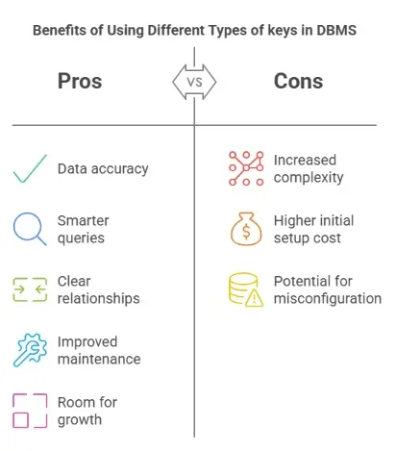
Pros. And Cons.

Slide 35
THANK YOU

